Slide 1
Career Pathways for Individuals with Disabilities (CPID)
CPID Overview: Purpose, Activities, and Outcomes

Slide 2
Today’s Objectives
Today we want to share our experiences and some factors that we believe other agencies would want to consider when infusing a Career Pathways focus/approach into their operations.
We will share some additional resources and contact information for further investigation.
Finally, we will share some information about our plans for more in-depth topical webinars.

Slide 3

Purpose - CPID Model Demonstration Projects
“The purpose of the Career Pathways for Individuals with Disabilities Model Demonstrations is to demonstrate promising practices in the use of career pathways in order to improve employment outcomes for individuals with disabilities.
Specifically, the projects are designed to promote State VR agency partnerships in the development of and the use of career pathways to help individuals with disabilities eligible for VR services, including youth with disabilities, to acquire marketable skills and recognized postsecondary credentials and secure competitive integrated employment in high–demand, high–quality occupations. “

Slide 4
CPID - Background
Grant funding was awarded to 4 state vocational rehabilitation agencies.
Each agency was essentially tasked with answering the same question: ‘Can you demonstrate how to use a career pathways model within VR?’
All projects used the same WIOA building blocks
WIOA definition
Skills and education
Workforce partners
Career counseling, etc.
Those building blocks are apparent in the structuring and prioritization used by the projects, but there are 4 distinct projects in the end.

Slide 5

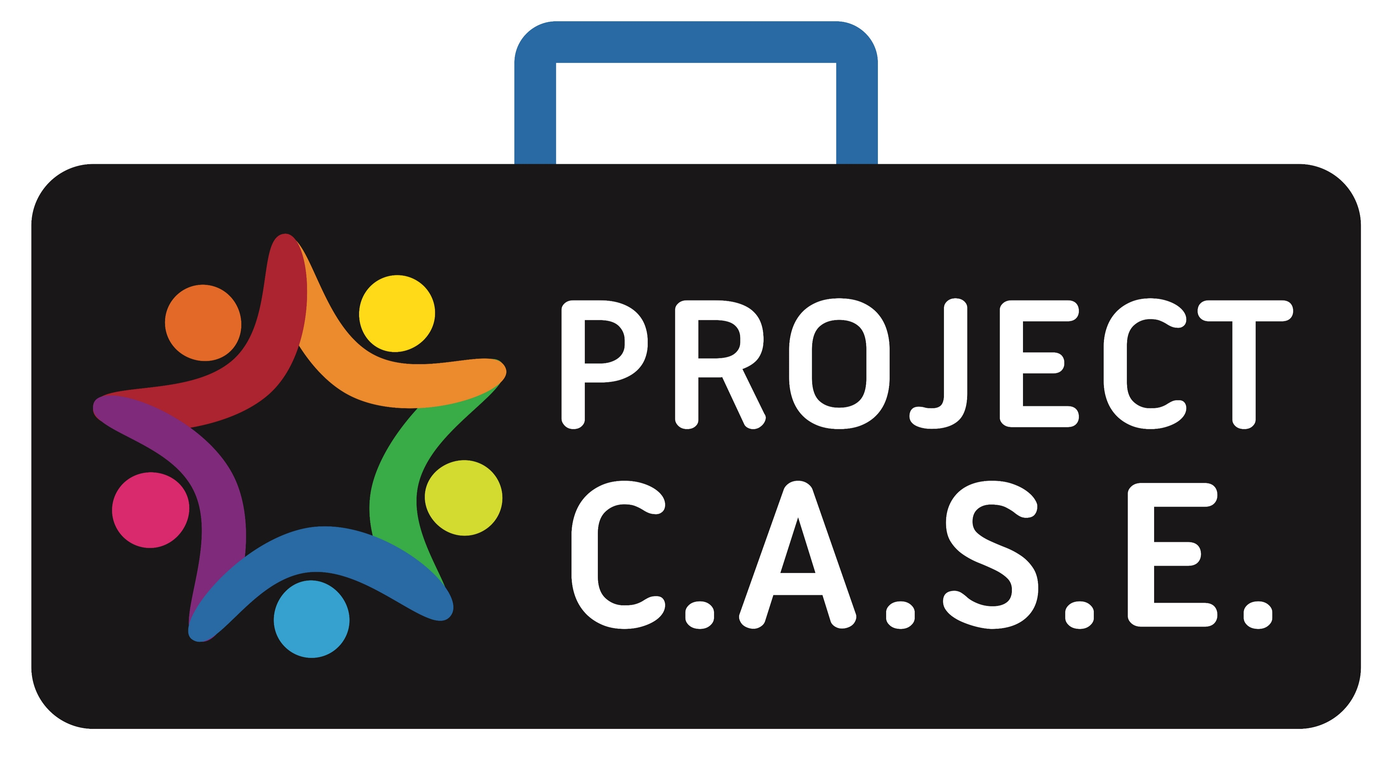


Today’s Presenters
Lee Bryan, Career Pathways for Georgia
Helga Gilbert, Kentucky’s Project CASE
Janet Drudik, Nebraska’s VR Career Pathway Advancement Project (CPAP)
Kate Kaegi, Virginia’s Career Pathways for Individuals with Disabilities

Slide 6
CPID PROJECTS – Important Related Constructs

Slide 7
Targeted Occupational Clusters
Manufacturing:
Kentucky, Nebraska, Virginia, Georgia
Healthcare, Information Technology:
Kentucky, Nebraska, Virginia
Transportation, Distribution, Logistics (TDL):
Nebraska, Virginia
Architecture/Construction:
Nebraska
Auto Mechanics and Welding:
Virginia
Notes:
Each of the four states identified high wage, high demand career pathways relevant to their states. States worked with businesses, community partners, and educational institutions to promote the various career pathways in their states. As you can see all states identified manufacturing as a career pathway.
In addition Kentucky, Nebraska and Virginia chose Healthcare and Information Technology. Nebraska and Virginia also chose Transportation, Distribution and Logistics (TDL). Nebraska included the Architecture and Construction career pathway and Virginia also selected the auto mechanics and welding areas.

Slide 8
Credential Attainment
Expand the number of students and/or adults with disabilities participating in existing Career Pathways or newly developed Career Pathways.
Increase the number of credential realized by students and/ or adults with disabilities.
Ensure the legacy of the grant efforts through staff training and processes to support a VR culture of career development vs. job placement.
Enhance the role of the Career Pathways Specialists and other VR Transition staff in the integration of best practice case management to sustain a culture of career development within the VR program.
Aggregate Total of Credentials Obtained = GA – 331; KY – 345; NE – 140; VA – 278.
Expand # PWD participating in Career Pathways
Increase # of credential realized by PWD
Ensure legacy of effort
Sustain a culture of career development
Notes:
Some states worked with students and others with adults, but the goal of all states were to obtain credentials. This was completed by:
Expanding the number of students and/or adults with disabilities participating in existing Career Pathways or newly developed career pathways.
Increasing the number of credentials realized by individuals with disabilities
Ensuring the legacy of the grant efforts through staff training and processes to support a VR culture of career development vs. job placement.
Enhancing the role of the Career Pathways Specialist, VR Transition staff and/or all VR staff in the integration of best practice case management to sustain a culture of career development within the VR program.

Slide 9
Workforce Partners
Provide outreach and develop relationships with Workforce Partners from grant inception
Co-Enroll Clients – Share business leads through business account managers
Planned tours of businesses for WIOA partners
Industry specific academies and industry tours
Develop relationships with the community colleges.
Working closely with Department of Education and Career, Technical and Agricultural Education.
Notes:
The goal of all states were to enhance the relationship with workforce partners and/or educational institutions. This may have looked differently depending upon the state, however all CPID grantees provided outreach and developed enhanced partnerships with workforce partners in some capacity. For example, Kentucky hired three of the Pathway Coordinators and a supervisor through KentuckianaWorks workforce area so Kentucky had partner input from the beginning.
Depending upon the state these partnerships included Adult Education, DOL, participating on Career Pathway Boards, and working with many additional WIOA partners. Relationships with educational partners are key in credential attainment.
CPID grantees have the opportunity to participate with workforce partners and educational institutions for such activities as Reserve Job Fairs, organizing grant events, co-enrolling job seekers, trainings through WIOA partners, customized trainings and tours of educational institutions.

Slide 10
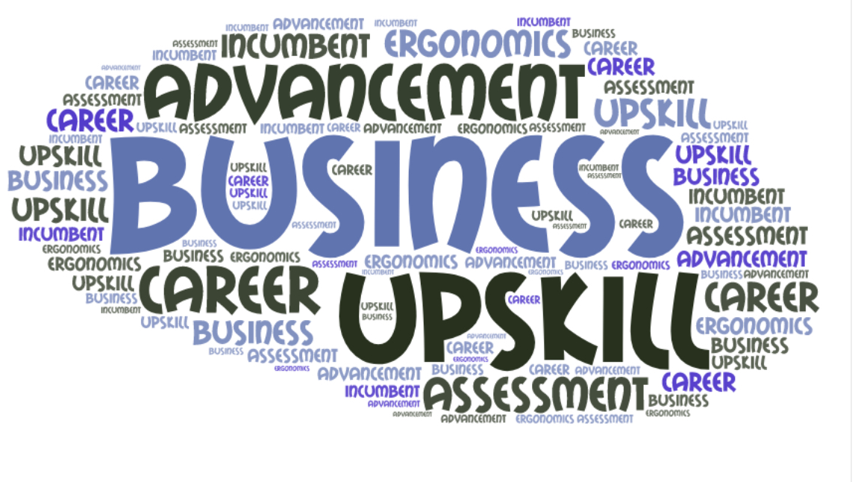
Business
Industry specific academies and industry tours Lean Accessibility Program Assessments
Ergonomic Assessments
Advancing incumbent workers
Providing training to businesses regarding Section 503, ADA, Disability Awareness and Disability Etiquette
Business and Job Seeker Ergonomic Assessments
Notes:
Each state knew the importance of the dual customer approach and promoting career pathways not just with the client, but also with businesses. States chose different avenues to engage businesses, however the success of promoting career pathways through business was crucial to the demand side of the equation for each grantee. All states chose to participate in industry specific academies and industry tours. These may have included client’s informational interviews and discussing credentials needed within the career pathways. Businesses assist job seekers in understanding entrance and exit points as it relates to their industry. Some states use Business Service Teams or Business Account Managers to assist in working with businesses, developing relationships and customized training programs.
Some states participated in Lean Accessibility Program Assessments and/or Ergonomic Assessments for businesses or working with a client for an ergonomic appropriate work station. States may have chosen to provide trainings such as Section 503, ADA, Disability Awareness and Disability Etiquette trainings. One state chose to advance their incumbent workers through their upskill/backfill model, but whatever the activity grantees and their job seekers benefited from engaging businesses

Slide 11
Apprenticeships, Customized Employment
Welding and Logistics cohort training
Hershey Boot Camp
Paid Internships
Wilson Workforce Rehabilitation Center Credential Training and Preapprenticeships
VR Certificate Programs
Notes:
Business driven, short-term, real life trainings provided both technical hard skills and soft skills training giving workers the opportunity to acquire the skills they need to pursue in-demand jobs and careers. These partnerships were developed through relationships with businesses and community partners.
Pre-apprenticeship programs and customized training programs were developed or sustained programs with grant funding.
These programs include the great work in Virginia with the Hershey Boot Camp, the Pre-apprenticeship and credential training program at Wilson Workforce Rehabilitation Center and also Virginia’s welding and logistics training.
Nebraska continued their VR certificate programs in the areas of CNA and Electrical Helper.

Slide 12
Internal Agency Operations
Statewide VR Counselor Outreach
Career Pathways Training and importance of industry recognized credentials
Implementation of bi-weekly Transition Talk to share Career Pathways information and provide training to VR staff
Introduction of a new agency Transition website with a central focus on Career Pathway
Motivational Interviewing
Career Pathway Website
Notes:
All states have been involved in outreach to their state VR agencies and working with VR staff. Grantees have provided training to VR staff through presentations, training materials, outreach with marketing materials and articles in VR internal newsletters. All states participated in discussions with their VR staff regarding the career pathway model.
Georgia implemented bi-weekly Transition Talk to share information and provide training to VR staff. They also introduced an agency transition website with a central focus on career pathways.
Virginia staff were trained in motivational interviewing and developed a career pathway website.
Additional information regarding the four state models will now be shared by Georgia Coopersmith from Virginia.

Slide 13

Distinctive Features
Project Commonalities/Differences
Nebraska used the upskill, backfill model.
Virginia focused on staffing subject matter experts to support Career Pathway efforts.
Kentucky focused on the Career Pathway Coordinator role.
Georgia focused on the high school population.

Slide 14
Outcomes, Systems Change, and Sustainability: Each state’s story

Slide 15
Career Pathways for Georgia and the Continuum of VR Services
Pre-Employment Transition Services
9th & 10th Grades
Exposure to Career Pathways through Career Exploration
Job Shadowing & Industry Tours
VR Eligible Students
11th & 12th Grades
Individual Plan for Employment (IPE) supportive of Career Pathway participation and completion
Additional Pre-Employment Transition Services & other VR services to support Career Pathway participation and completion
Unpaid Work Based Learning
Work Readiness Training
Post-Secondary & Transition Planning for a career path for students with disabilities
Counseling & Guidance

Slide 16
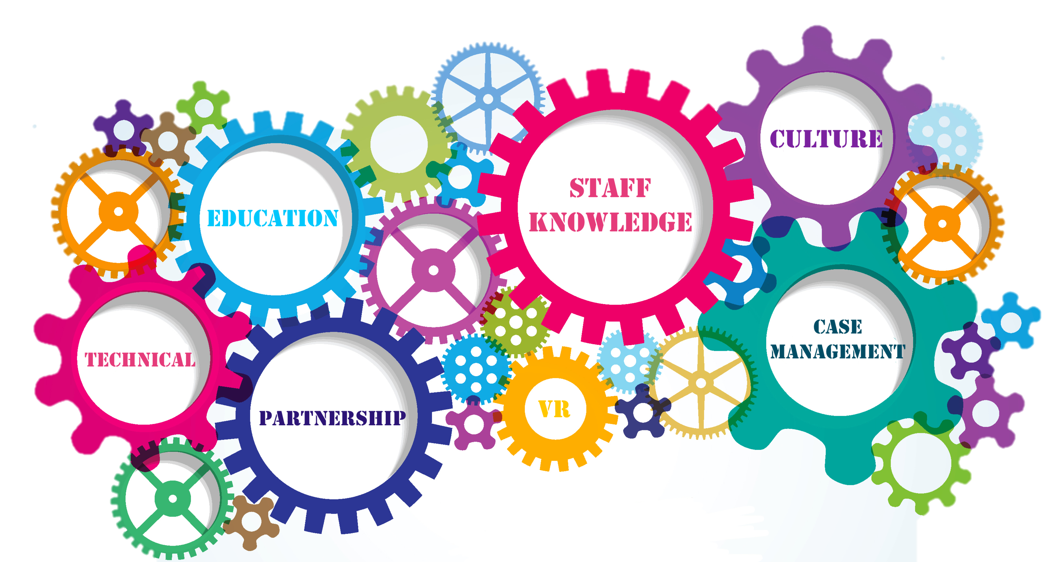
Career Pathways for Georgia (1 of 3)
Career Pathways & VR
Culture of VR
Staff Knowledge
Case Management
Local Educational Agency
Students and Families
Critical Partnership
Georgia Department of Education
Career, Technical and Agricultural education
Career Technical Instructors (CTI)

Slide 17
Career Pathways for Georgia (2 of 3)
Legacy of the grant:
Processes and procedures must support culture shift from job placement to career development.
Project team roles will set the tone of expectations for VR Transition staff.
Fostering strong collaboration within VR and the CTAE staff at the LEA to support increased student access to Career Pathways.
Staff training to not only understand Career Pathways access and completion expectations, but also supporting students through the continuum of VR services.

Slide 18
Career Pathways for Georgia (3 of 3)
Aggregate Number of Recognized Post-Secondary Credentials Obtained by Participants:
FY 2016 | FY 2017 | FY 2018 | FY 2019 | FY 2020
13 | 32 | 252 | 331 | 353
Participants have accessed 40 Career Pathways offered in school districts throughout Georgia.

Slide 19
Kentucky

Slide 20
Kentucky CPID (1 of 3)
Key Features
The role of the Career Pathways Coordinator
Career Pathways STEM events to provide quality PreEmployment Transition Services
Employer Engagement through tours, reverse job fairs, work experiences, etc.
Value and necessity of workforce partnerships

Slide 21
Kentucky CPID (2 of 3)
Participants | 2017 | 2018 | 2019
# CPID participants added each year | 720 | 326 | 323
# CPID participants in postsecondary training | 168 | 237 | 294
Aggregate # of credentials earned | 38 | 131 | 162
# CPID participants ready for employment | 81 | 191 | 274
# CPID participants closed in employment | 168 | 237 | 294

Slide 22
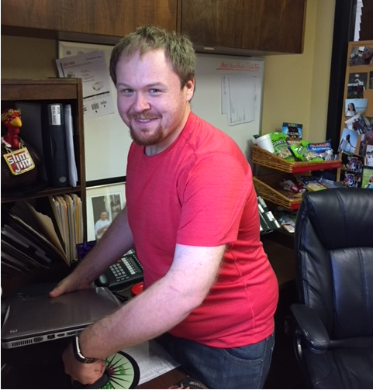
Jonathan’s Career Pathway
OVR consumer from Pikeville, KY
Associates of Science Big Sandy Community Technical College
A+ Computer Repair, Cisco Networking Basic, and Cisco Networking Enhanced
Bachelor’s degree in Computer Information Systems from Morehead State
HTML, Java, C++, Visual Studio, Microsoft Office, Apache, CSS, JavaScript, and Alice
Support Services addressed:
Personal Needs
Employability Skills
Job Entry Skills

Slide 23
Kentucky CPID (3 of 3)
Sustainability and Systems Change
Incorporate continuous staff development which encourages a Career Pathways approach to VR services and case management, with a focus on:
(IPE) Plan development that promotes in-demand credential attainment and advancement in a career
Referring consumers into workforce partner programs that enhance job readiness
Continue successful CPC services using VR Employer Services Branch staff to facilitate tours, work experiences
Use VR agency data to:
Tell a story of our skilled, credentialed job seekers
Provide timely targeted advising about job opportunities

Slide 24
Nebraska

Slide 25
Vision and Purpose of Grant
25
Upskill individuals with disabilities by providing opportunities to advance in their employment.
Backfill positions through access to Nebraska VR’s un-tapped talent bank.
Notes:
Nebraska’s CPID grant is the Upskill/Backfill model. This was chosen as the CPAP vision to promote autonomy, stability, and economic self-sufficiency achieved by career advancement along a career pathway with a focus on a single, stable, well paying job with employer-provided benefits to replace the one or more entry-level jobs currently held to make ends meet.
The goal is to upskill incumbent workers with businesses they are currently working and backfill with individuals with disabilities from the VR program who want to enter the same career pathway.
The CPAP model is a Dual-Customer Approach serving both clients and businesses.
After developing the relationship with the business to help upskill past successfully closed clients and backfill with VR clients, it helps businesses retain their key talent and assist in filling vacant position with a qualified candidate with a disability.

Slide 26
Nebraska: CPAP Outcomes
301 CPAP Cases
180 Cases Have Closed - 59.8%
121 Remain Open - 40.2%
95 Closed into Competitive Integrated Employment - 52.3%
Anticipated an additional 77 cases will close by the end of grant 9/30/20.
97.9% Clients increased their average weekly wage
76.8% Clients increased their employed provided benefits from application to closure
Notes:
301 clients have been served by CPAP. 180 cases have been closed and 121 remain open. 95 clients have closed into competitive integrated employment. We are anticipating an additional 77 cases will close successfully prior to this September 30th.

Slide 27

Nebraska: Weekly Wage Increase
Wages increased by an average of $387/week (median increase $300/week) from CPAP application to CPAP case closure
Weekly wages at closure: Average $899/week and median of $780/week
Weekly wages at application: Average $512/week and median of $520/week
Notes:
Wages increased by an average of $387/week from the time of CPAP application to the time at CPAP case closure.
Weekly wages at closure were reported as an average $899/week and median of $780/week;
Compared to weekly wages at application reported as an average of $512/week and median of $520/week.

Slide 28
Nebraska: Benefit Increase
73 out of 95 (76.8%) CPAP clients increased the total number of employer-provided benefits from application to closure.
Employer-provided benefits increased:
By a median count of 2 (mean of 2.17)
Seventeen clients (17.9%) had no change in benefits
Five (5.3%) had a decrease in benefits; however, this includes clients who had benefitted positions at application and maintained those benefits (no or minimal net change)
Of the 95 successful CPAP cases closed, only four are employed in non-benefitted positions
24 of 95 CPAP clients remained employed at the same business while most moved into positions with new employers.
Notes:
73 out of 95 clients have increased the total number of employer-provided benefits from the time of application to time of closure.
The number of employer-provided benefits increased by a median count of 2. Seventeen clients had no change in benefits, and five had a decrease in benefits; however, this includes clients who had benefitted positions at application and maintained those benefits. Of the 95 successful cases closed, only four are employed in non-benefitted positions.
About a quarter of CPAP clients remained employed at the same business, while most moved into positions with new employers.

Slide 29

Nebraska: Sustainability and Systems Change
Career Advancement as a VR Service to Jobseekers and Incumbent Workers
Communication and Outreach Around Career Advancement as a VR Service Category
Career Advancement as a Dual-Customer Strategy
Notes:
Since grant inception there has been ongoing considerations for Sustainability and System Change. Three items have been outlined within this area. The first being Career advancement as a VR service to jobseekers and incumbent workers.
VR has the statutory authority to work with individuals with disabilities in advancing in their careers. Less clear is whether public VR agencies have
“Advancement in employment” as a focus area” and have the capacity/alignment of resources to support career advancement as an agency priority;
Given limited resources, how should VR agencies prioritize clients seeking career advancement services and supports over other employment needs such as job development. This is especially challenging for states in an order of selection with a wait list.
A Consideration Could be does “Career Advancement Services” for all state VR agencies fall under a separate title similar to the current authority for Supported Employment Services?
The second sustainability and system change is Communication and outreach around career advancement as a VR service category:
If career advancement is to become a core service provided to jobseekers and incumbent workers, it will require reframing a client’s view of VR as a one-time service to a career-long engagement that builds on past successes.
Thirdly, Career advancement as a dual-customer strategy is part of the sustainability and system change.
VR agencies should consider offering employers services and supports that promote advancement of incumbent workers with disabilities. Including:
Translating VR eligibility information in a way that resonates with businesses and incumbent workers - for example: reframing the word “disability”
Managing a pipeline of VR applicants generated from business outreach as another entry point to VR
Developing mechanisms to support employers in backfilling recently vacated positions when an individual advances in their career. This is critical whether the individual advances within the same employer or moves to a new employer.

Slide 30
Virginia

Slide 31
Virginia CPID Demographics
73% are aged 14-23
85% are MSD
Affected by OOS
Individuals in Delayed Status
Both DARS and DBVI
Notes:
Final 16 months – delated status

Slide 32
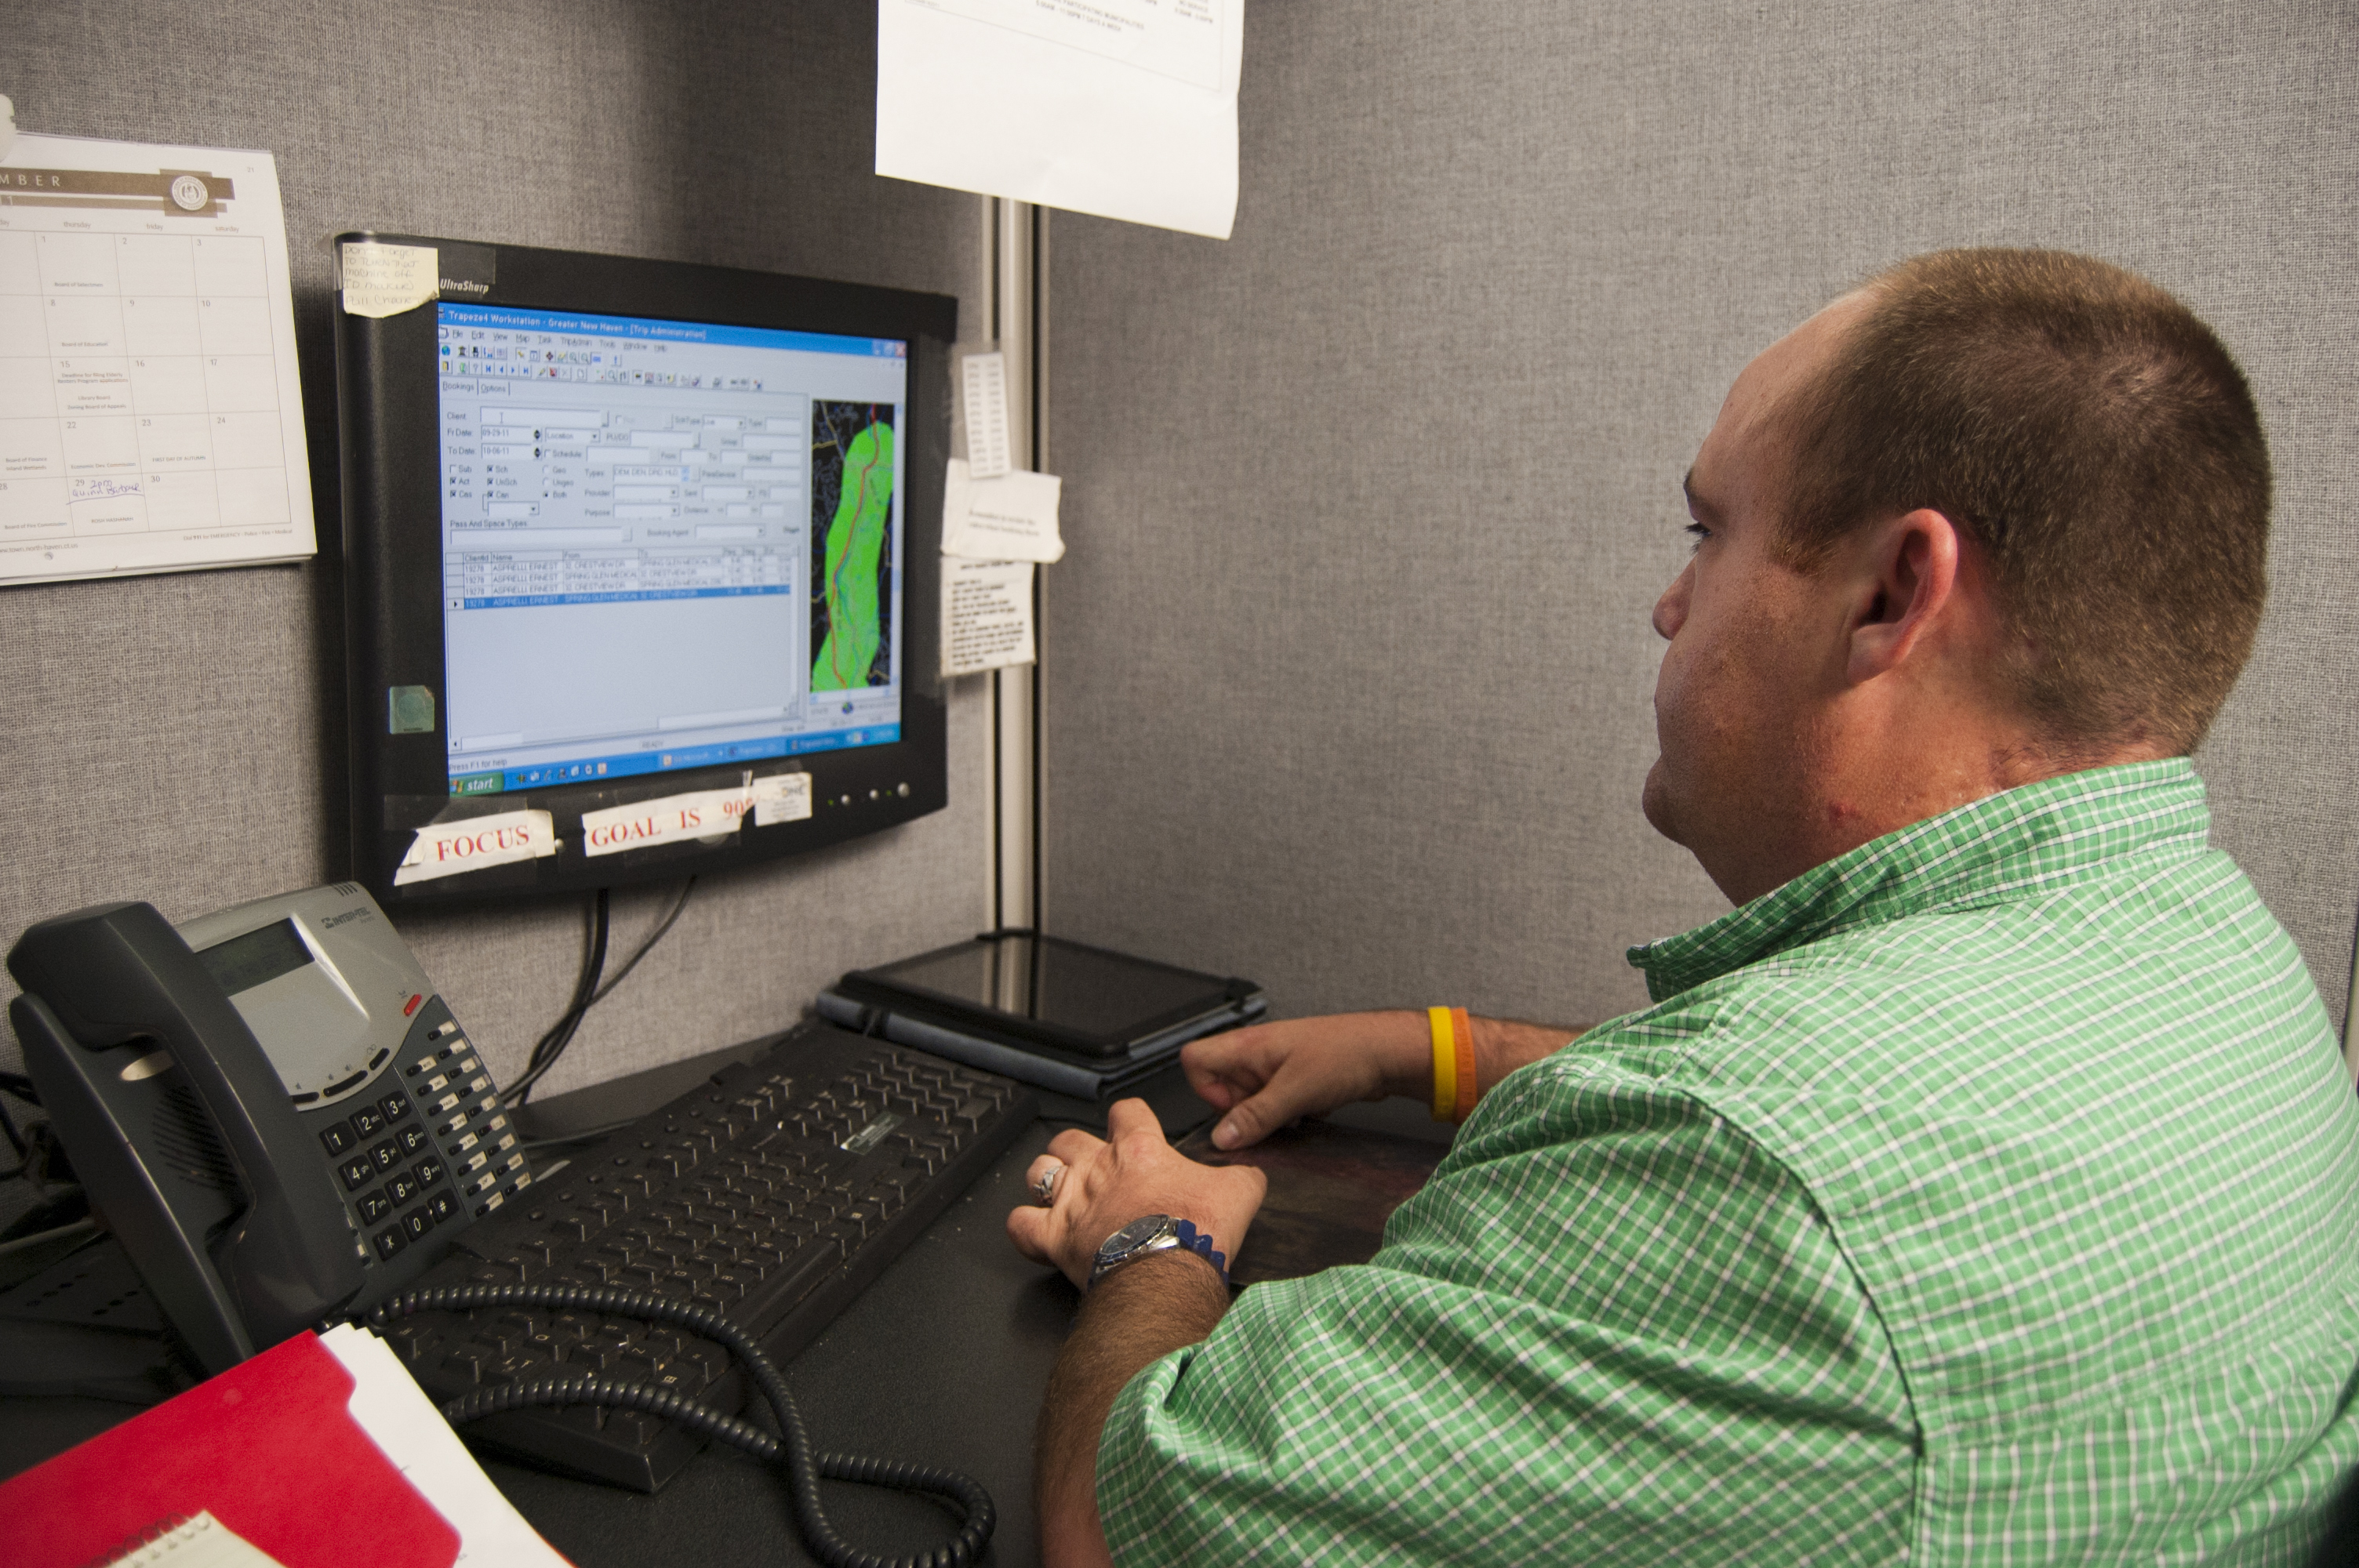
Virginia Sustainable Strategies
Business Driven Strategies
Training/Credential Training
Assistive Tech/Occupational Therapy
Pilot with Wilson Workforce and Rehabilitation Center
Accessible Training: Cohort Development & Supports

Slide 33
Virginia WIOA Collaborations
Workforce Co-Enrolled
Adult Education
Partnerships with VCCS and other Training Providers
Relationships built with VA Manufacturing Association and Northern VA Technology Council

Slide 34
Virginia Outcomes
34
Outcome Elements | 2016 | 2017 | 2018 | 2019 | 2020
Number of participants currently enrolled in career pathways training | 9 | 31 | 57 | 150 | 160
Credentials Obtained | 8 | 16 | 65 | 133 | 56
Number Closed with CIEOs | 7 | 28 | 93 | 140 | 32
VR Integration (DARS and DBVI)
Credentials
Delayed Candidates
Employed
Notes:
Counselor
Pre-ETS Career Exploration
Academies
Trainings

Slide 35

Stay Tuned
2 page Information Sheet linked to webinar
Tool Kits
In-Depth Webinars

Slide 36
For More Information
Georgia – Lee Bryan - Lee.Bryan@gvs.ga.gov
Kentucky – Helga Gilbert - Helga.Gilbert@ky.gov
Nebraska – Janet Drudik - Janet.Drudik@nebraska.gov
Virginia – Kate Kaegi - Kate.Kaegi@dars.virginia.gov

Slide 37
Thank you!

